Slide 1
Financial Tools for an Infusion Clinic

Slide 2
Financial Analysis Format
A standard format of both layout and content for financial schedules will ensure consistency from one business plan to the next.
Each schedule should begin with a heading that includes:
  Line 1: Title of the project (e.g., “Service Line Expansion”)
  Line 2: Description of the contents (e.g., “Capital Expenditures”)
  Line 3: Exhibit identification (e.g., “Exhibit V)

Slide 3
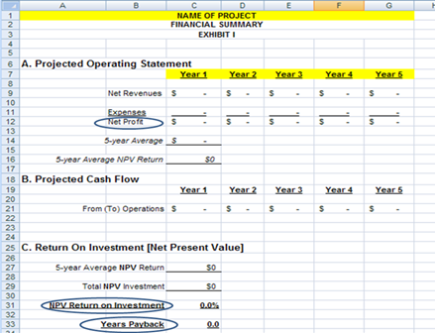
Financial Analysis
Exhibit I: Financial Summary
Schedule of the major financial indices of the project
Projected revenues
Expenses, capital investment required
Net income, contribution, or return on investment
Exact content depends on the nature of the plan.
Notes:
Net revenue (charges * collection rate) – both hospital & profee practice
Year 1 may have start-up costs (e.g., facility renovation, recruitment, corporate communication fees)
- Current & projected hospital margin for SC inpatients

Slide 4
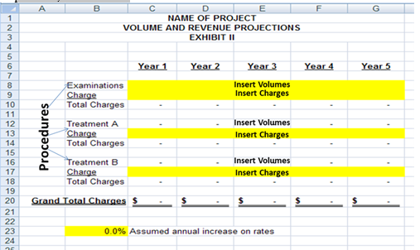
Financial Analysis
Exhibit II: Volume and Revenue Projections
This example shows three new procedures performed with charges and volumes for each, and then totaled
Notes:
For SCD Program, included volumes by treatment node:
inpatient admissions by source (ED, Clinic, Direct); LOS; annual profitability
Outpatient volumes & collection rates
Included an Exhibit with state data on outpatient visits at other hospitals & % of market that JH had by inner city, central MD, Other

Slide 5
Financial Analysis
Exhibit III: Staffing Assumptions
Shows the number of FTE’s (by job type) which will be required for the new service.
This example reflects staffing positions to consider for a service expansion.

Slide 6
Financial Analysis
Exhibit IV: Project Operating Statement.
Show revenues, collections, expenses and net margin for each year of the service.

Slide 7
Additional Financial Exhibits
Request assistance from your finance department to help develop the applicable financial exhibits for your proposal.
Be the SME on the clinical data and program design.
Major Supplies – to meet projected volumes
Capital Expenditures
  New buildings, renovation to existing space, major equipment purchases
  Capital items need a useful life estimation to derive depreciation expense
Projected Balance Sheet – derived from the operating statement and capital purchase assumptions
Annual cash flow, as derived from the operating statement & balance sheet
Return on Investment (ROI) – payback statistics
Sensitivity Analysis – to show if the project can absorb unfavorable circumstances
Notes:
Many of the concepts in the sample exhibits are self-explanatory.
Others, like developing projected balance sheets, require experience with fairly abstract accounting concepts.
Request assistance from your finance department as appropriate to provide support during the development of these exhibits or to review your draft exhibits.

